Slide 1
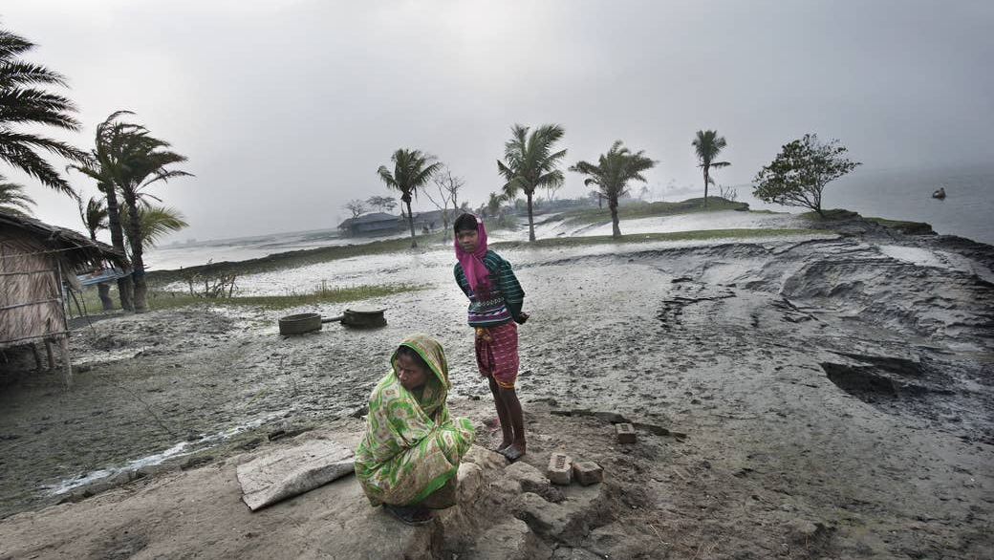
How to define the
next generation of road funds
to provide resilience and sustainability of transport networks and corridors?

Slide 2
Rethinking Resilience
Transport = enabler of economic growth

Slide 3
Climate-Resilient Transport Strategy
Impact of CC on Transport Networks and Economic Implications of Climate-Related Disruptions: Cost of transport disruptions for households and firms in low- and middle-income countries varies between $391 billion and $647 billion per year.
Supply chain disruptions slowed Africa’s GDP growth to 3.1% in 2022 down from 4.5% in 2021. Shipping and transport costs keep increasing.
Positive socio-economic impacts on people and businesses: Investing in climate-resilient transport infrastructure could lead to an estimated $4.2 trillion increase in global GDP by 2040 through improved access to markets and services.
Why is Climate-Resilient Transport Development Crucial

Slide 4
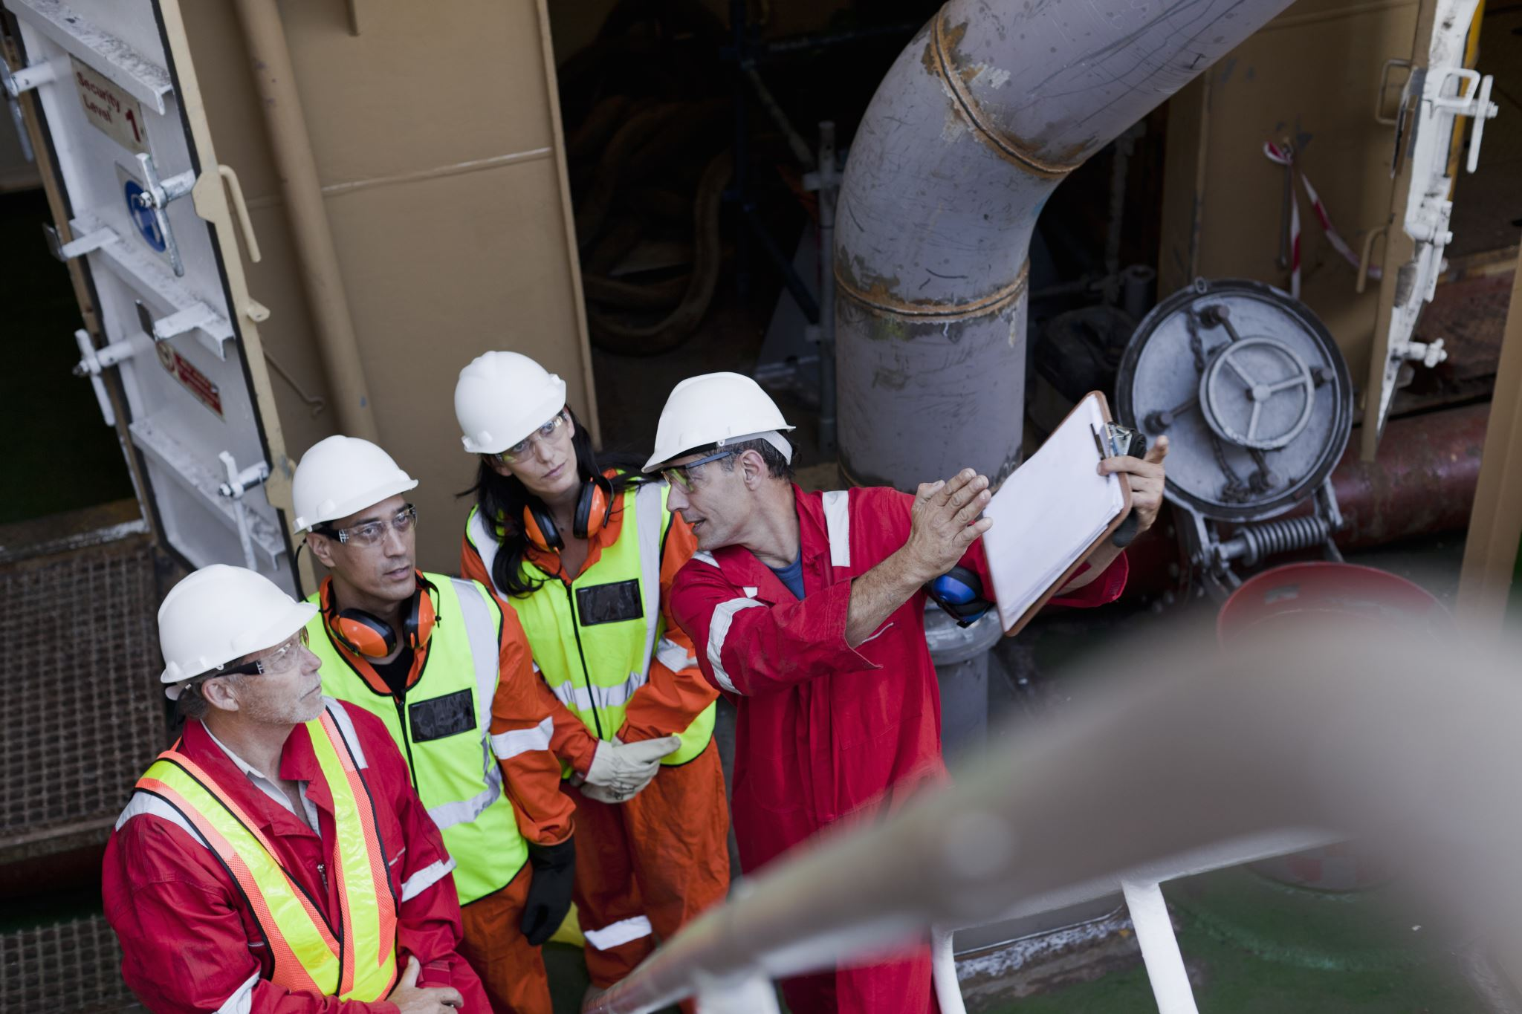
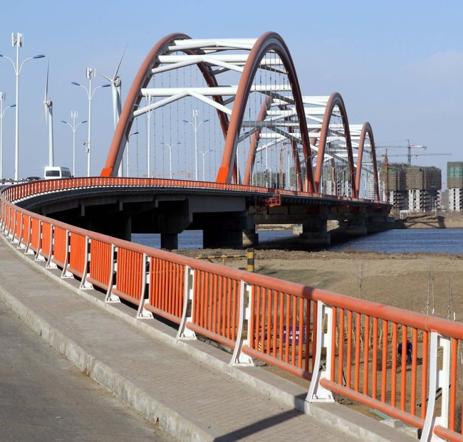
Climate-Resilient Transport Strategy
Current focus on asset-level interventions:
Transport sector operations rely heavily on the inclusion of Engineering and Design measures, and then O&M in second place.
Shifting Paradigms:
Toward Sustainable
Transport Services Provision

Slide 5

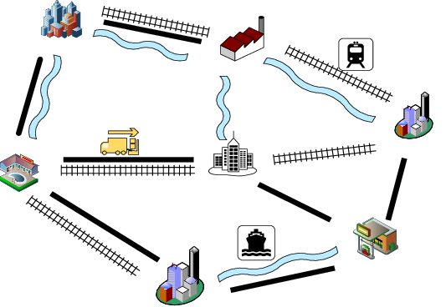

Climate-Resilient Transport Strategy
Climate-Resilient Transport for Sustainable Services, Trade and Logistics:
Sustainable transport development plays a major role in promoting economic growth and social equity. Requires holistic, system-level and multimodal development strategies.
Shifting Paradigms:
Toward Sustainable
Transport Services Provision

Slide 6

Climate-Resilient Transport Strategy
The Life-Cycle Approach – 5 pillars for a more comprehensive approach
System Planning & Financing
Engineering & Design
Operations & Maintenance
Contingency Planning
Institutional Capacity & Coordination
System Planning & Financing
Engineering & Design
Operations & Maintenance
Contingency Planning
Institutional Capacity & Coordination
1
2
5
4
3
> Role of road funds <

Slide 7
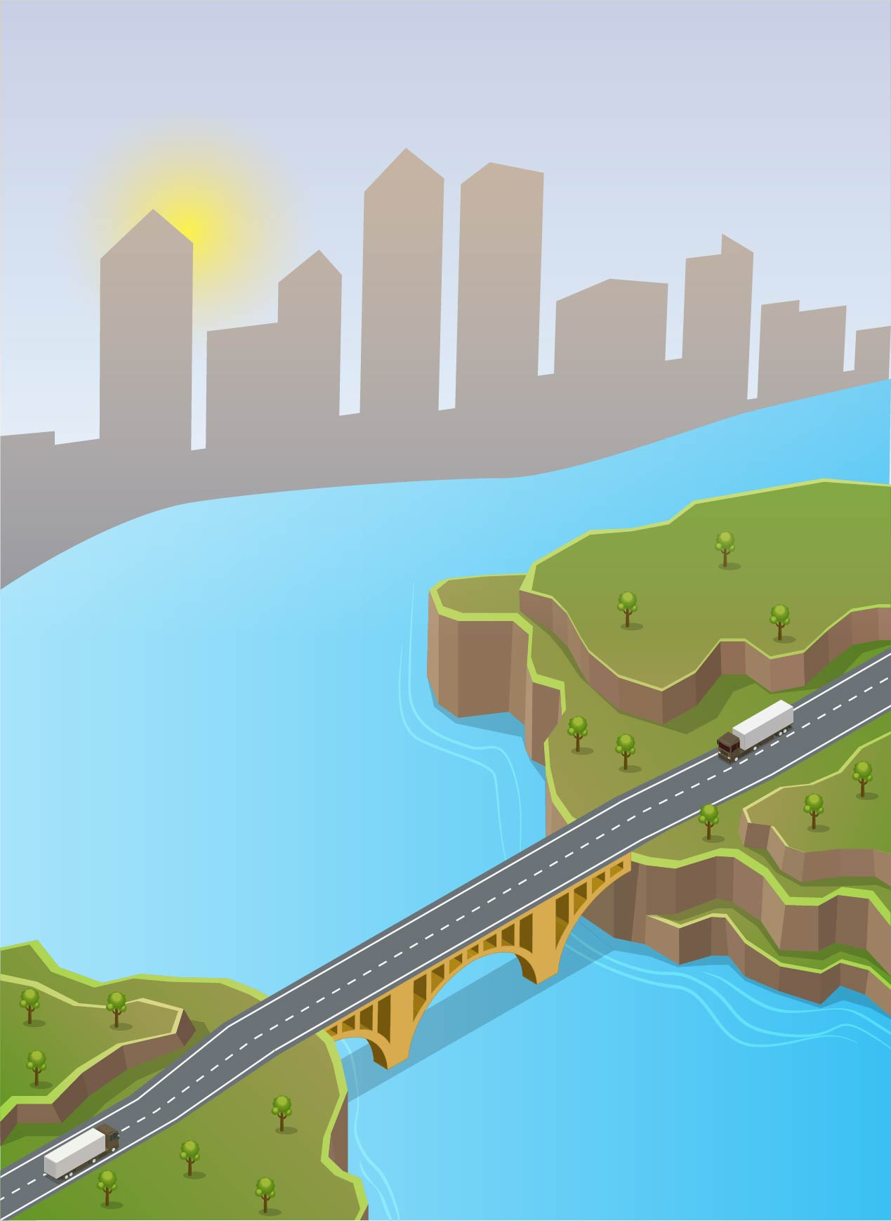


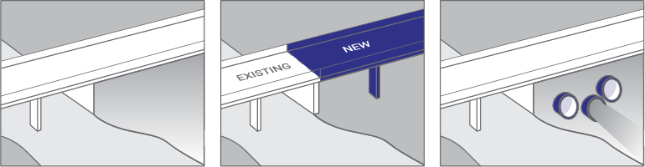

Tools and Systems to Enhance Investment Planning
Cost-benefit analysis OF
Plan A - $130 Million
Plan B - $41 Million
2 investment plans reflecting
Expensive structural interventions that can absorb high impact stressing
[Applied to: 31 bridges, 910 km of roads]
‘Low-regret’ interventions that enhance performance in frequent events
[Applied to: 24 bridges, 790 km of roads]
nation-wide retrofit program
Return on Resilience Investment*
River widening
Erosion Control
Road rehabilitation
Road Drainage
Benefit (US$)
BCR
ROI
Cross-drainage culverts
Plan A
Scour protection & pier reinforcement
Plan B
Relief openings
Saves
$290 Million
Returns
$7 for every $
Returns
12% Annually
Inadequate protection during high-impact events
*For a 50-year investment horizon with 6% discount rate

Slide 8
Resilience is not an add-on cost but an investment that generates returns
$1 > $4

